Slide 1
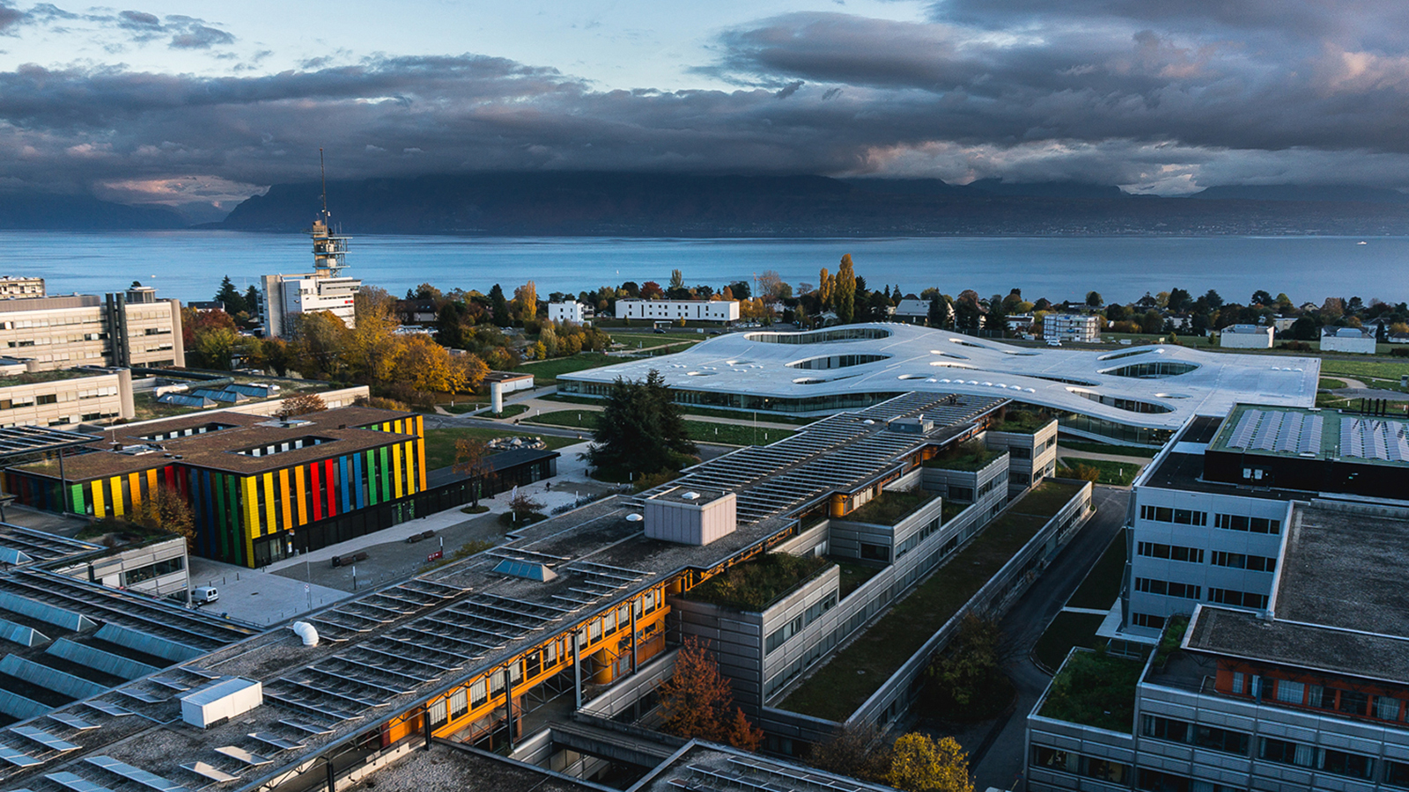

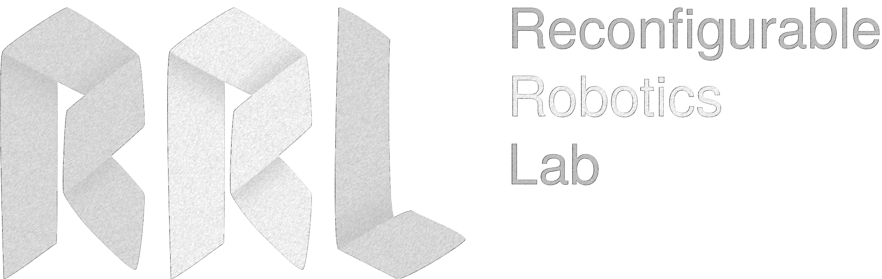
SPA Toolkit Project Presentation
June 4th, 2018
Presenter : Cleres David, CSE – Master 2
Supervisor: Prof. Jamie Paik
École Polytechnique Fédérale de Lausanne – EPFL
RRL

Slide 2
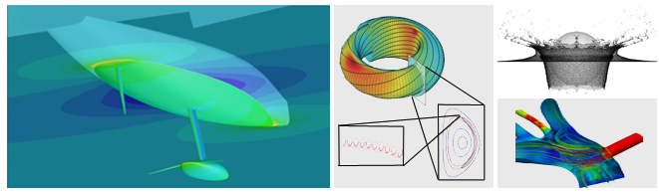
Computational Science & Engineering (CSE)
CSE Semester Project = 8 ECTS (during the semester)
Rules
“The project takes between 1 and 1.5 days / week.”
Weekly supervision through meetings with the PhD/ Post-Doc Student
Report at the end of the project
Oral presentation
Source: EPFL website
Notes:
About the lab

Slide 3
SPA Toolkit
“A comprehensive, cohesive, and open-source simulation and design tool for soft actuators using the finite element method (FEM) […]”
Source: RRL website
Notes:
About the lab

Slide 4

Project Timeline (1)
Implementation of the GUI
Access to the SCITAS Clusters
Week 2
Week 4
Week 6
Week 1
Week 3
Week 5
Week 7
Set-up weekly meetings with Alice
Getting started with the SPA Toolkit
First ideas for a Graphical User Interface (GUI)
Look how the interface could fit in the toolkit
Focus on the plot generating files
Problems of library compatibility between coded GUI and clusters
Notes:
About the lab

Slide 5
Project Timeline (2)
Implementation of the GUI
Access to the SCITAS Clusters
Tutorial Building on GitHub
Week 9
Week 11
Week 13
Week 8
Week 10
Week 12
Week 14
Generation of Material files
Image Processing tool
Notes:
About the lab

Slide 6
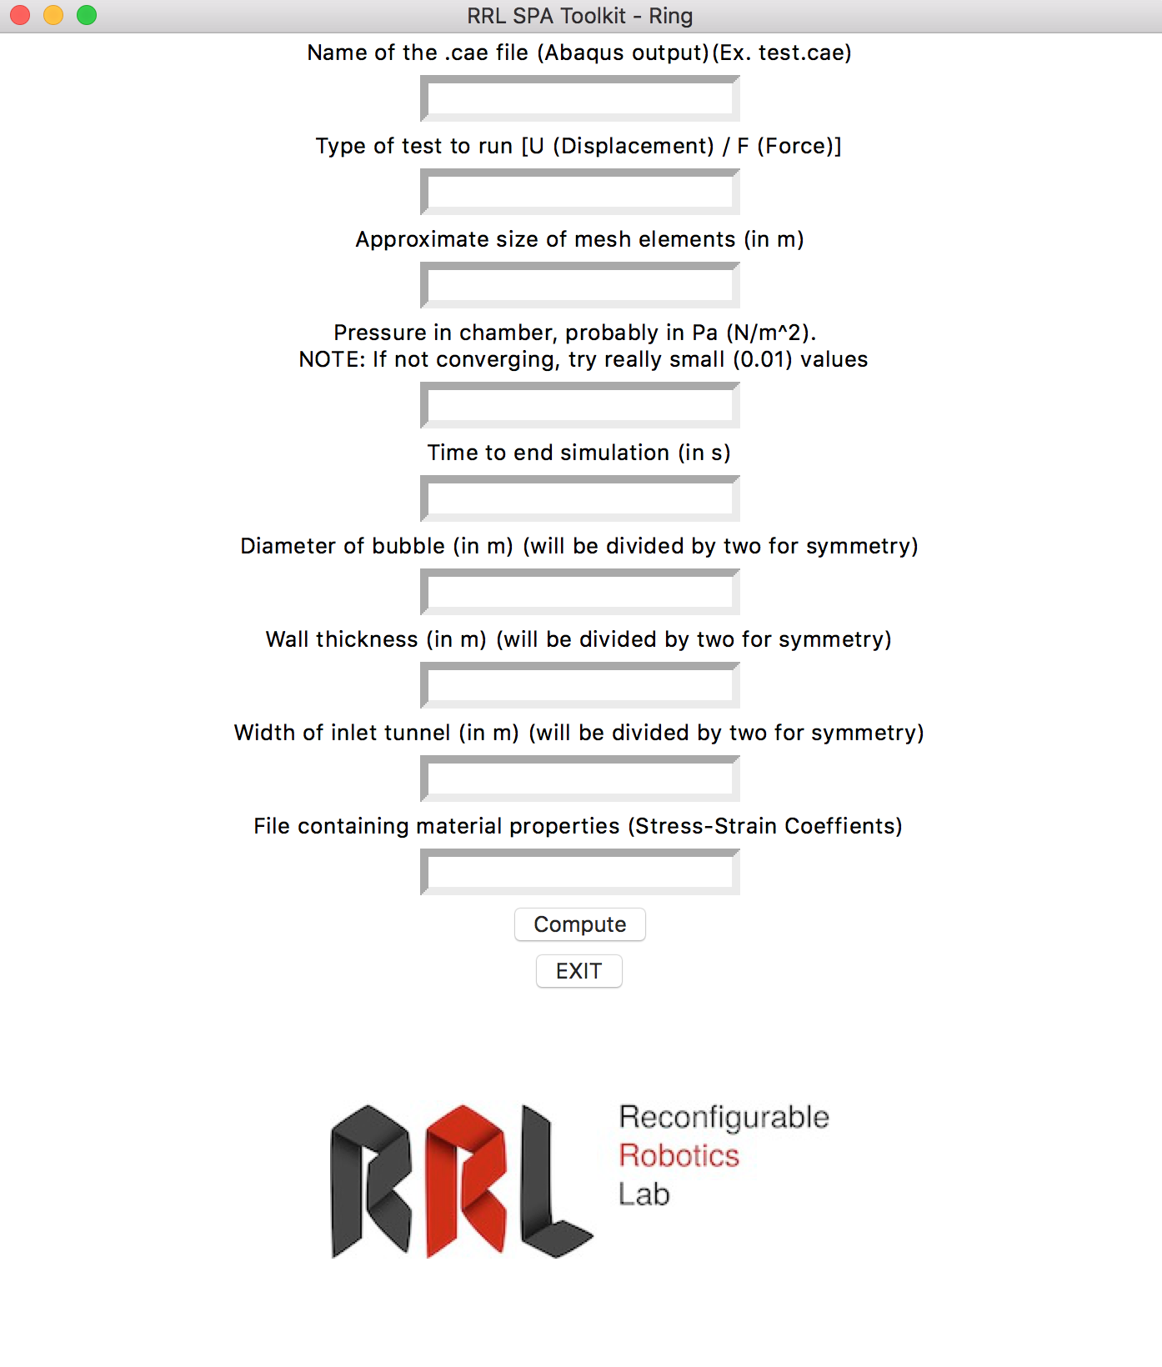
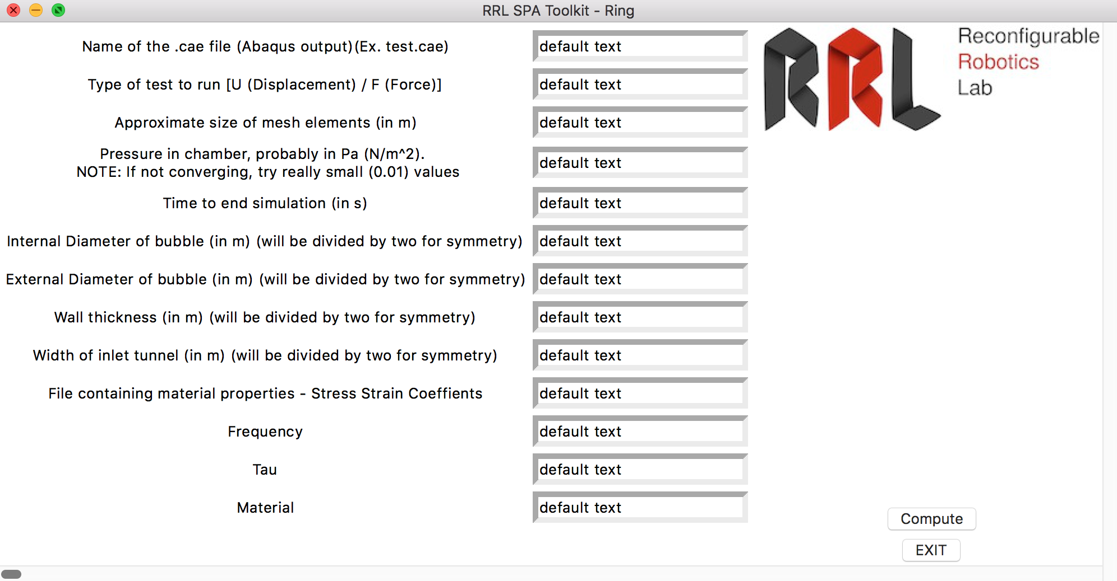
Structure – Version 1
Plot Data
SPA Toolkit
Abaqus
outfile.odb
outfile.cae
create_geom.py
Abaqus Independent GUI
Invisible for the user
SCITAS
OUTPUT
Notes:
About the lab

Slide 7
Structure – Version 2 – Abaqus Plug-in
Abaqus Dependent GUI
Plot data
SPA Toolkit & Abaqus
outfile.odb
create_geom.py
SCITAS
Notes:
About the lab

Slide 8
Future Objectives (1)
Automatic generations of a chosen set of plots
Energy
Displacement
Internal Pressure
Displacement vs. Pressure
Etc.
Module that eases object selection (inlet, outlet, points, meshes, …)
Notes:
Details of the plots and how we want to implement them will be discussed with Alice afterwards
"module" pour faciliter la sélection des surfaces (inlet/outlet) ou points qui nous intéressent (on verra concrètement ce qu'on fera, en fonction de mon avancement aussi). Ce n'est pas la peine de détailler (ne parle pas trop des mailles etc, je pense que ça va compliquer la comprehension
travail de recherche préliminaire qui permettrait de mieux définir les différentes possibilités d'interface, éventuellement avec un logiciel plus largement utilisé par la communauté des soft robotics (j'avais déjà vaguement mentionné la question/le problème lors d'une présentation donc ça ne sort pas de nulle part).
Modules = libigl or viewvox → Problème = selecting single surface / meshes

Slide 9
Future Objectives (2)
Simpler workflow for the user (omitting the Abaqus part to the user)
Organizing the program files
Code in a more accessible manner
Rapidly understand which files to run and how
Larger choice of materials (Not only Ecoflex 30)
Integration of feedback of previous users
Building a tutorial
Notes:
About the lab

Slide 10
Questions ?

Slide 11
